Slide 1
Input-Output and Interrupt
Input-Output Configuration,
Program Interrupt, and
Interrupt cycle

Slide 2
Input-Output and Interrupt
Instructions and data stored in memory come from some input device.
Computational results must be transmitted to the user through some output device.

Slide 3
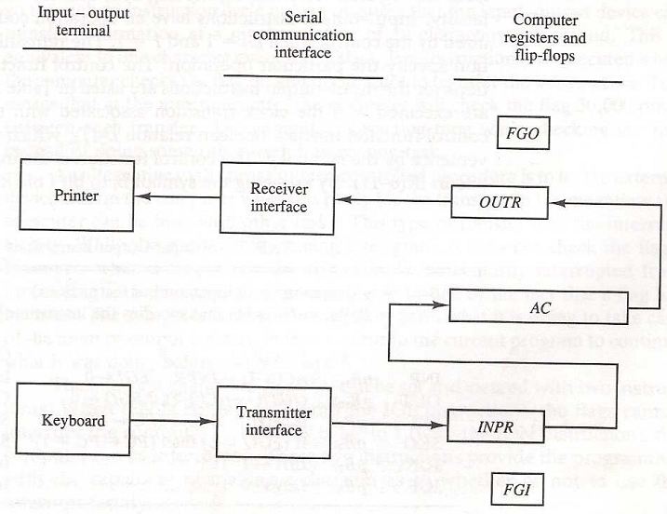
Input-Output Configuration
The terminal sends and receives serial information.
Each quantity of information has eight bits of an alphanumeric code.
The serial information from the keyboard is shifted into the input register INPR.

Slide 4
Input-Output Configuration
The serial information for the printer is stored in the output register OUTR.
These two registers communicate with a communication interface serially and with the AC in parallel.

Slide 5
Input-Output Configuration
The input register INPR consists of eight bits and holds alphanumeric input information.
The 1-bit input flag FGI is a control flip-flop.

Slide 6
Input-Output Configuration
The flag bit is set to 1 when new information is available in the input device and is cleared to 0 when the information is accepted by the computer.
The output register OUTR works similarly but the direction of information flow is reversed.

Slide 7
Input-Output Configuration
Initially, the input flag FGI is cleared to 0.
When a key is struck in the keyboard, an 8-bit alphanumeric code is shifted into INPR and input flag FGI is set to 1.

Slide 8
Input-Output Configuration
As long as the flag is set, the information in INPR cannot be changed by striking another key.

Slide 9
Input-Output Configuration
Initially, the output flag FGO is set to 1.
The computer checks the flag bit; if it is 1, the information from AC is transferred in parallel to OUTR and FGO is cleared to 0.

Slide 10
Input-Output Configuration
The output device accepts the coded information, prints the corresponding character, and when the operation is completed, it sets FGO to 1.
The computer does not load a new character into OUTR when FGO is 0.

Slide 11
Input-Output Instructions
Input and output instructions are needed for transferring information to and from AC register, for checking the flag bits, and for controlling the interrupt facility.
Input-output instructions have an operation code 1111 and are recognized by the control when D₇ = 1 and I = 1.
The remaining bits of the instruction specify the particular operation.

Slide 12
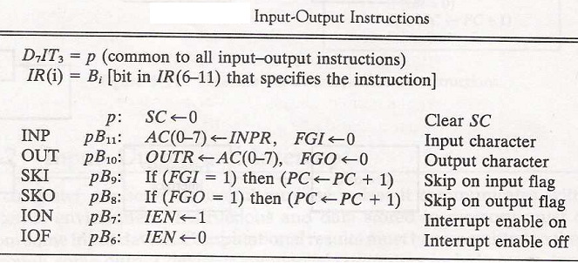
Input-Output Instructions
These instructions are executed with the clock transition associated with timing signal T₃.
Each control function needs a Boolean relation D₇IT₃, which we designate for convenience by the symbol p.

Slide 13
Input-Output Instructions
The control function is distinguished by one of the bits in IR (6-11).
By assigning the symbol B_{i} to bit i of IR, all control functions can be denoted by _{p}B_{i} for i = 6 though 11.

Slide 14
Input-Output Instructions
The sequence counter SC is cleared to 0 when p=D₇IT₃=1.
The last two instructions set and clear an interrupt enable flip-flop IEN.

Slide 15
Program Interrupt
The computer keeps checking the flag bit, and when it finds it set, it initiates an information transfer.
The difference of information flow rate between the computer and that of the input—output device makes this type of transfer inefficient.
An alternative to the programmed controlled procedure is to let the external device inform the computer when it is ready for the transfer.
In the meantime the computer can be busy with other tasks. This type of transfer uses the interrupt facility.
While the computer is running a program, it does not check the flags.

Slide 16
Program Interrupt
When a flag is set, the computer is momentarily interrupted from the current program.
The computer deviates momentarily from what it is doing to perform of the input or output transfer.
It then returns to the current program to continue what it was doing before the interrupt.
The interrupt enable flip-flop IEN can be set and cleared with two instructions.
When IEN is cleared to 0 (with the IOF instruction), the flags cannot interrupt the computer.
When IEN is set to (with the ION instruction), the computer can be interrupted.

Slide 17
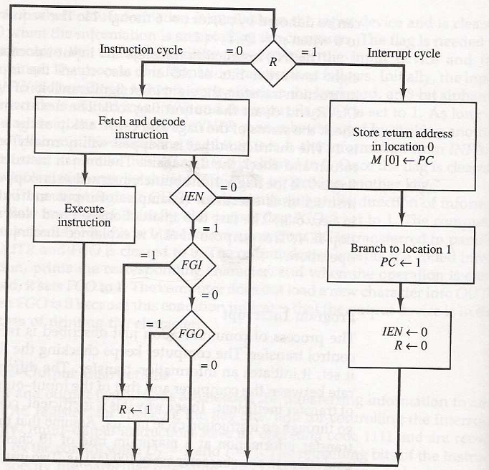
Program Interrupt
An interrupt flip-flop R is included in the computer. When R = 0, the computer goes through an instruction cycle.
During the execute phase of the instruction cycle IEN is checked by the control.

Slide 18
Program Interrupt
If IEN is 0, it indicates that the programmer does not want to use the interrupt, so control continues with the next instruction cycle.
If IEN is 1, control checks the flag bits. If both flags are 0, it indicates that neither the input nor the output registers are ready for transfer of information. In this case, control continues with the next instruction cycle.

Slide 19
Program Interrupt
If either flag is set to 1 while IEN = 1, flip-flop R is set to 1. At the end of the execute phase, control checks the value of R, and if it is equal to 1, it goes to an interrupt cycle instead of an instruction cycle.

Slide 20
Interrupt Cycle
The interrupt cycle is a hardware implementation of a branch and save return address operation.
The return address available in PC is stored in a specific location.
This location may be a processor register, a memory stack, or a specific memory location.

Slide 21
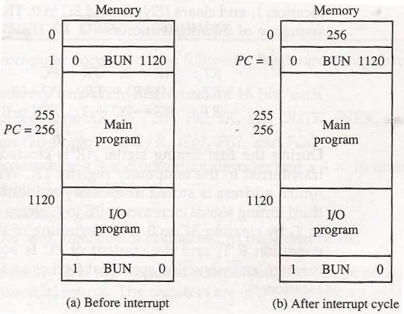
Interrupt Cycle
When an interrupt occurs and R is set to 1 while the control is executing the instruction at address 255.
At this time, the returns address 256 is in PC.
Fig: Demonstration of the interrupt cycle
The programmer has previously placed an input—output service program in memory starting from address 1120 and a BUN 1120 instruction at address 1.

Slide 22
Interrupt Cycle
When control reaches timing signal T₀ and finds that R = 1, it proceeds with the interrupt cycle.
The content of PC (256) is stored in memory location 0, PC is set to 1, and R is cleared to 0.
Fig: Demonstration of the interrupt cycle
The branch instruction at address 1 causes the program to transfer to the input—output service program at address 1120.

Slide 23
Interrupt Cycle
This program checks the flags, determines which flag is set, and then transfers the required input or output information.
Once this is done, the instruction ION is executed to set IEN to 1 (to enable further interrupts),
Fig: Demonstration of the interrupt cycle
and the program returns to the location where it was interrupted.

Slide 24

BUN: Branch Unconditionally
BUN: Branch Unconditionally is an Memory-Reference Instructions.
The BUN instruction allows the programmer to specify an instruction out of sequence and we say that the program branches (or jumps) unconditionally.
The instruction is executed with one microoperation:
This instruction transfers the program to the instruction specified by the effective address.

